Slide 1
Phase 2: Regression Problem
Life Expectancy Prediction| ML Group Project (Fall 2025-2026)
Ma’moun Hussam Yosef – 0233493 (Team Leader)
Ahmad Hani Habab - 2213575
Hazim Majdi Alazab - 0222280

Slide 2
Dataset Selection & Overview
• Dataset: Life Expectancy (WHO) Data Set.
https://www.kaggle.com/datasets/kumarajarshi/life-expectancy-who
• Target: Life expectancy (age).
• Features: 21 features including Country, year, Alcohol, Population etc.
• Justification for the Choice:
Rich, real-world features → health, economic, and demographic factors enable meaningful prediction.
Continuous target variable → life expectancy is numerical, making it well-suited for regression models.

Slide 3
Preprocessing Pipeline
• Data Cleaning:
• - Dropped ‘status' column.
• - Dropped rows that doesn’t have target value (10 rows)
• - Encoding : label encoding for the country column.
• - Splitting:
80% Train, 20% Test for linear regression and Gradient Boosting regressor.
70% Train, 15% Validation, 15% Test for the MLP regressor.
• Feature Scaling:
• - StandardScaler (Z-score normalization).

Slide 4
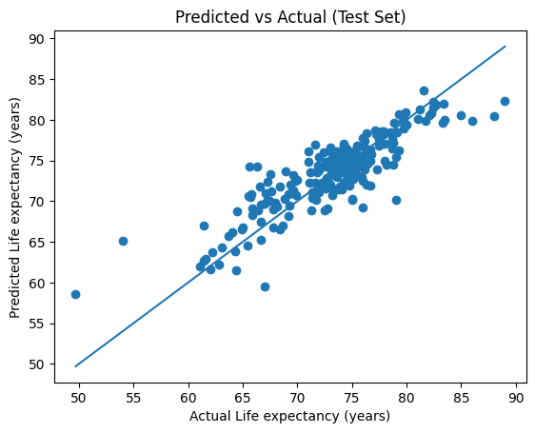
Baseline: Linear Regression Scores
We used a simple Linear Regression as a baseline mode
• Test Set Results:
Compared to the Benchmarks, the R2 score was 0.9202.
Matric | Value
MSE | 7.358
RMSE | 2.712
MAE | 1.977
R2 Score | 0.7447

Slide 5
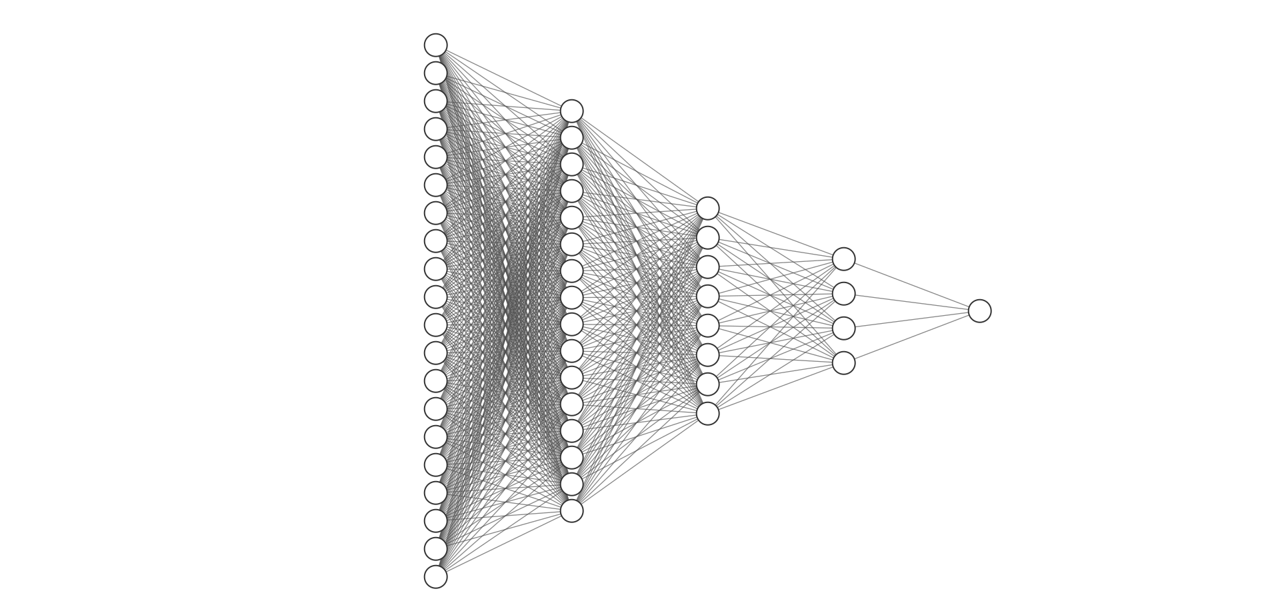
Advanced 1: MLP regressor
A small neural network with 3 hidden layers with the corresponding number of neurons: [16, 8, 4]
Hyperparameters:
- Activation Function: ReLU for each neuron in the hidden layers.
- Optimizer: Adam optimizer with a learning rate of 0.001.
• - dropout_rate: 0.1
• - number of epochs: 250
Results (Testset):
Matric | Value
MSE | 0.1884
RMSE | 0.4341
R2 Score | 0.8185

Slide 6
Advanced 1: Hyperparameter Search (optuna)
Possible parameters to tune: (with validation loss as the considered matric)
lr: [0.0001-0.01]
n_hidden_layers: [2, 3, 4]
dropout: [0.0-0.5]
hidden_sizes: [4, 6, 8, 10, 12, 14, 16] for each hidden layer
Turns out that the best parameters are lr : 0.0076, n_hidden_layers : 3, dropout : 0.0003, hidden_sizes : [14, 16, 6]
With the Parameters turned the following metrics achieved better results:
- MSE decreased from 0.1884 to 0.0815
- RMSE decreased from 0.4341 to 0.2855
- R² increased from 0.8185 to 0.9215

Slide 7
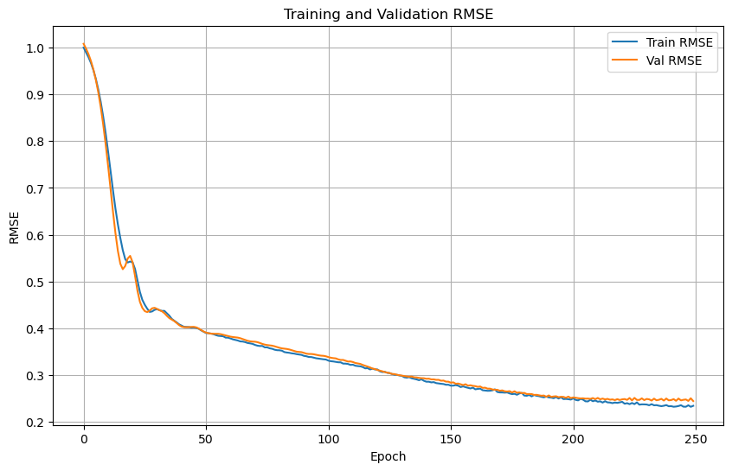
MLP visualization

Slide 8
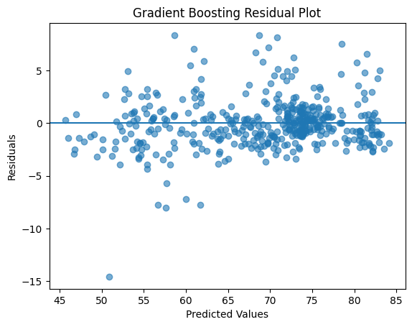
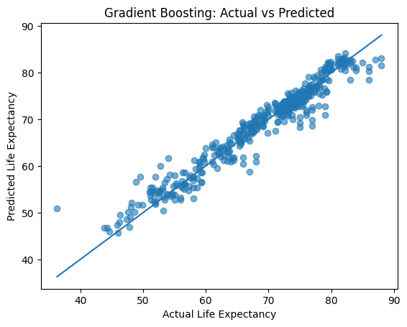
Advanced 2: Gradient Boosting Regressor
The Gradient Boosting Regressor achieved the following results (Testset):
Matric | Value
MSE | 5.560
RMSE | 2.358
MAE | 1.656
R2 Score | 0.9409

Slide 9
Thank You
Phase 2: Regression Problem
Life Expectancy Prediction| ML Group Project (Fall 2025-2026)
Ma’moun Hussam Yosef – 0233493 (Team Leader)
Ahmad Hani Habab - 2213575
Hazim Majdi Alazab - 0222280

